Slide 1
Learning from examples: types of machine learning, decision trees, nearest neighbours
How does a machine learn a rule from examples, and how much can I trust what it learned?
Applied AI and Automation | Session 2 of 14
KLAi Professional Learning | Jotham Martin Wambi
Notes:
Welcome back. Last time a picture became numbers, a neuron scored them, and a small network learned its weights from labelled digits. Today we ask a wider question: how does a machine learn a rule from examples, and how much can you trust what it learned?
We start with the plainest form of machine learning. You will see the four types of learning, a decision tree, and k-nearest neighbours. As before, each idea starts with an everyday example, a spam filter, an umbrella, a house price, and then the numbers and the standard name.
After that comes the business application, on real data: the forty Nile Valley Foods customer messages and a table of expense claims. The set is small, so we also learn to ask how honest a score is.

Slide 2



Today in one view: what you will leave with
By the end of today you will have
Name the four types of machine learning, and tell classification from regression
Read a decision tree, from an umbrella tree to one drawn from real data, and follow one case down it
Explain k-nearest neighbours with a house price, and why 40 examples give only a rough score
Notes:
That question breaks into three things you can do by the end. Here is what you leave with. You can name the four types of machine learning and tell classification from regression. You can read a decision tree and follow one case down it. And you can explain k-nearest neighbours with a house price, and say why forty examples give only a rough score.
These ideas apply to any decision you make from past cases, in finance, operations, HR, sales, compliance or legal work. Nothing to submit, and nothing to be tested on.

Slide 3
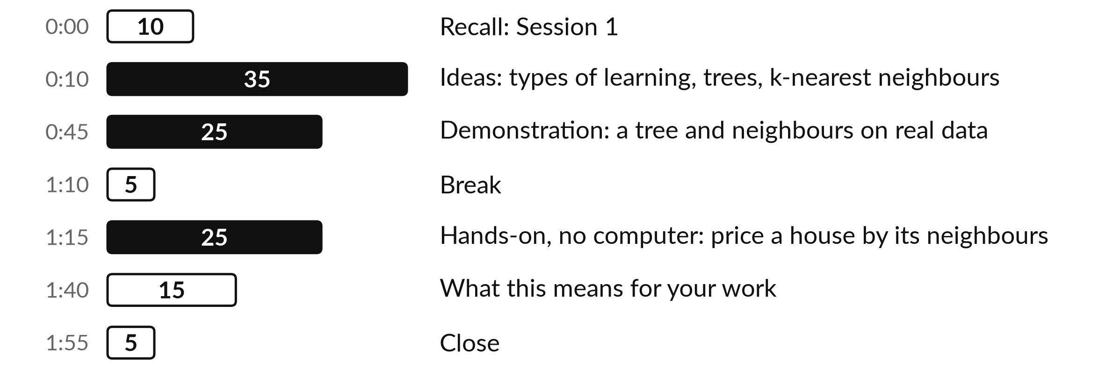
Your two hours: examples in,
rules out, and an honest score
I run the demonstration. You score a grid on paper and decide where this fits your work.
Notes:
To get there in two hours, today has three big parts. First the ideas, about thirty-five minutes: the four types of learning, a decision tree, and k-nearest neighbours. Then a demonstration, about twenty-five minutes, on real data: the forty Nile Valley Foods customer messages and a made-up table of expense claims.
After the break you estimate a house price from its nearest neighbours on a grid, on paper, for twenty-five minutes. The last fifteen minutes are for what this means for your work. Before any of that, a look at how today fits the course, and then five words.

Slide 4

Three questions from last time
1. How many numbers describe a colour picture that is 8 by 8 pixels?
2. How does a neuron turn its inputs into one output?
3. What happened when we moved every digit one pixel?
Answer aloud first. Then we check together.
Notes:
Three quick questions from Session 1. Answer aloud first, and then we check together. It is a warm-up to bring last time back.
Question one. How many numbers describe a colour picture that is 8 by 8 pixels? Take a moment.
A good answer is this. 192: 8 x 8 pixels, and three numbers for each pixel (red, green and blue).
Question two. How does a neuron turn its inputs into one output? Say it to yourself first.
A good answer is this. It computes a weighted sum, adds the bias, then applies an activation function, such as a step for yes or no, or ReLU.
Question three. What happened when we moved every digit one pixel? Think about your own work as you answer.
A good answer is this. Accuracy fell from 97% to 46%. The network is only good at cases like the ones it saw.
If an answer was missing, last session’s take-away sheet or workbook page has it. Now to today.

Slide 5
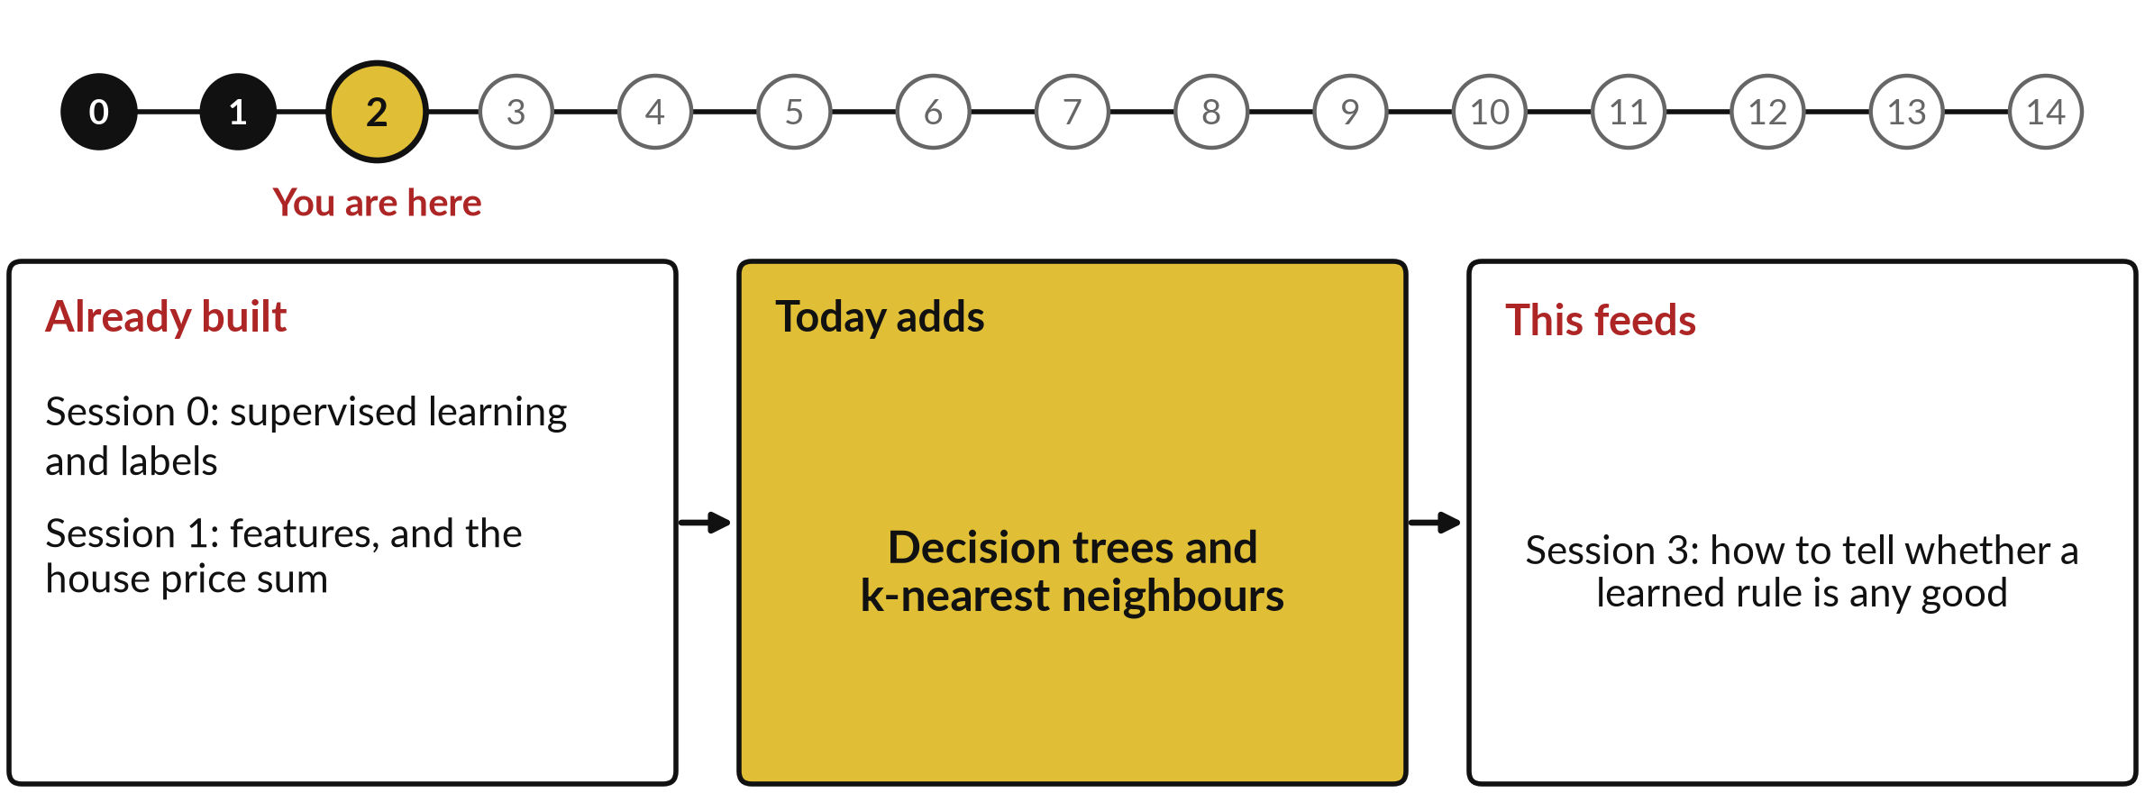
How today connects: what we
already have and what it feeds
Each session is built on the ones before it.
Notes:
So where does today sit in the story? The dots along the top are the fifteen sessions, from the map at Session 0 to your plan at Session 14, and the gold one is today.
We already hold supervised learning and labels from Session 0 and features, and the house price sum from Session 1. Nothing today starts from zero.
What today adds is this: decision trees and k-nearest neighbours.
And it feeds straight into what comes next. Session 3: how to tell whether a learned rule is any good. Keep that chain in mind, because each idea you learn today is a step on it.

Slide 6




Words we use today
Word | What it means
Label | The correct answer attached to an example, such as spam or a house price.
Classification | Predicting a category, such as spam or not spam. Predicting a number is regression.
Decision tree | A model made of yes-or-no questions on features, ending in an answer.
k-nearest neighbours | Predict from the k most similar training examples, found with a distance metric.
Cross-validation | Split the data into k folds, train on k-1, test on the held-out fold, rotate and average.
Notes:
Five words for today. I give the plain meaning of each, and we use every one of them before the end of the session.
Label. The correct answer attached to an example, such as spam or a house price.
Classification. Predicting a category, such as spam or not spam. Predicting a number is regression.
Decision tree. A model made of yes-or-no questions on features, ending in an answer.
k-nearest neighbours. Predict from the k most similar training examples, found with a distance metric.
Cross-validation. Split the data into k folds, train on k-1, test on the held-out fold, rotate and average.
Keep those words close. The first idea uses them straight away, so let us begin.

Slide 7
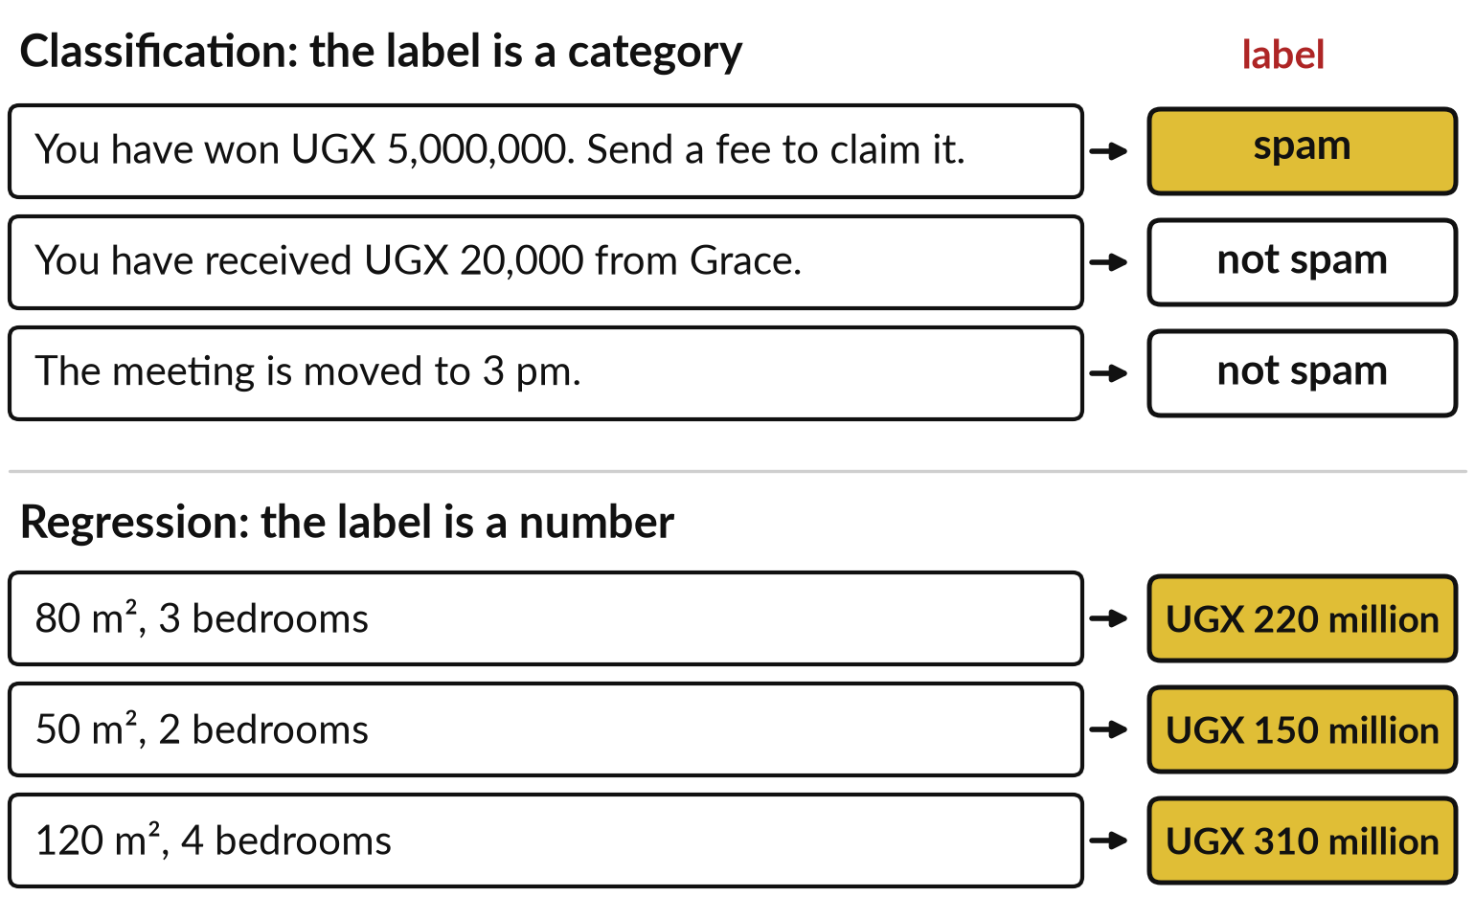
Supervised learning shows the machine
examples with the right answer attached
A spam filter learns from messages already marked spam or not spam.
The features are the input: here, the words of a message.
The label is the right answer. A category is classification, a number is regression.
Houses: floor area and bedrooms in, price out.
Notes:
Let us start with something your phone already does. A spam filter learns from examples: messages that people have already marked spam or not spam. The message is the input, described by features such as its words, and the answer attached to it is the label. That is supervised learning: examples with the right answer attached.
When the label is a category, as with spam, the task is classification. When the label is a number, as with a house price from floor area and bedrooms, the task is regression. You priced those houses in Session 1. The machine looks for a rule that links features to labels, then applies it to a new case. At work, the same idea sorts customer messages.

Slide 8
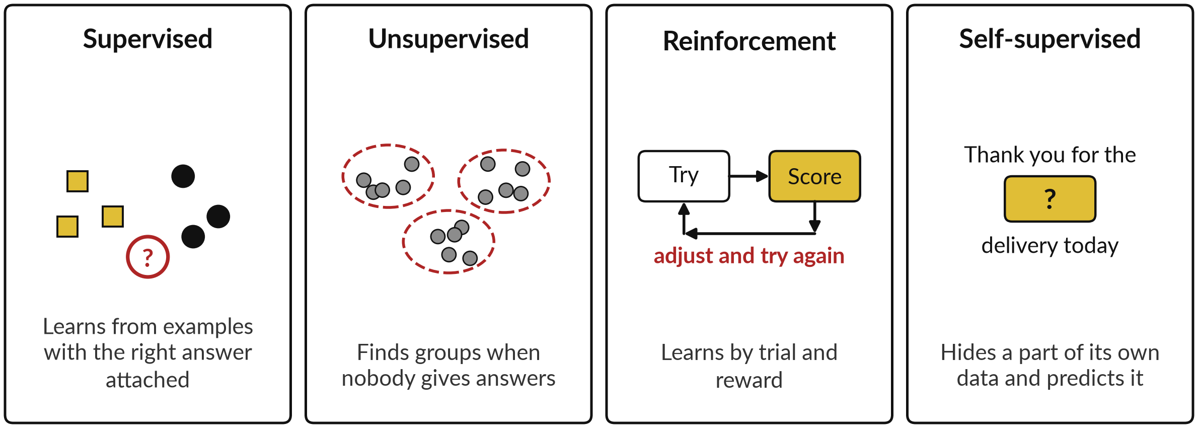
There are four ways for a machine to learn
Most business tools use supervised or self-supervised learning.
Notes:
Supervised is one of four types, and all four came up in Session 0, so here they are as pictures. Supervised: examples with the right answer, like the spam filter, and the machine guesses the answer for a new case. Unsupervised: no answers at all, and the machine finds groups, such as songs that sound alike.
Reinforcement: the machine tries something, gets a score, adjusts and tries again, as you would learn a video game. Self-supervised: the machine hides a part of its own data, such as a word, and learns to predict it, like the phone keyboard that suggests the next word. That is how language models are trained, and we come back to it in Session 5.

Slide 9





Every type of learning has an
everyday example and a business use
Type | Learns from | Everyday example | At work
Supervised: classification | Labelled examples | Spam or not spam | Customer service: sort a message as order, payment, complaint or other
Supervised: regression | Labelled examples | House price from floor area | Finance: predict next month’s cash
Unsupervised | No labels: it finds groups | Group songs that sound alike | Compliance: find payments unlike the rest
Reinforcement | Trial and reward | Learning a video game by score | Operations: choose delivery routes
Self-supervised | Hidden parts of its own data | Phone keyboard suggests the next word | Any office: a language model predicting the next token
Notes:
You may have named one already. Here is an everyday example and a business use for each type. Classification: a spam filter, and customer service sorting a message as order, payment, complaint or other. Regression: a house price from floor area, and finance predicting next month’s cash. Unsupervised: grouping songs that sound alike, and compliance looking for payments unlike the rest, with no list of known bad payments.
Reinforcement: learning a video game by score, and operations learning which delivery routes work best. Self-supervised: the phone keyboard, and a language model predicting the next token. Today we spend our time on supervised learning, because it is the most common in business. We begin with a model made of questions.

Slide 10
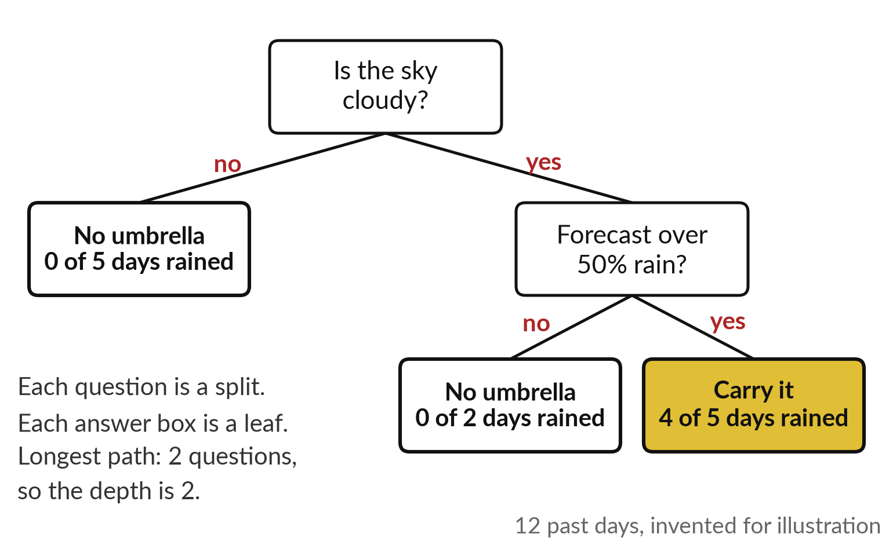
A decision tree asks yes-or-no
questions: should you carry an umbrella?
Twelve past days built this tree. A new day starts at the top.
Follow the answers down to a leaf: cloudy and over 50%, so carry it.
The questions are splits. The answer boxes are leaves.
The longest path asks 2 questions: the depth is 2.
Notes:
Now a model made of questions: a decision tree. Think of how you decide about an umbrella. Is the sky cloudy?
If not, leave it. If so, is the forecast over 50 per cent rain?
If not, leave it, and if so, carry it. A decision tree is a model made of yes-or-no questions about features. Each question is a split, each answer box is a leaf, and the number of questions along the longest path is the depth, here 2. I drew this tree from twelve invented past days: in the leaf on the right, 4 of 5 days rained.
A new day follows the answers down until it reaches a leaf. Next, how a computer chooses the first question.

Slide 11
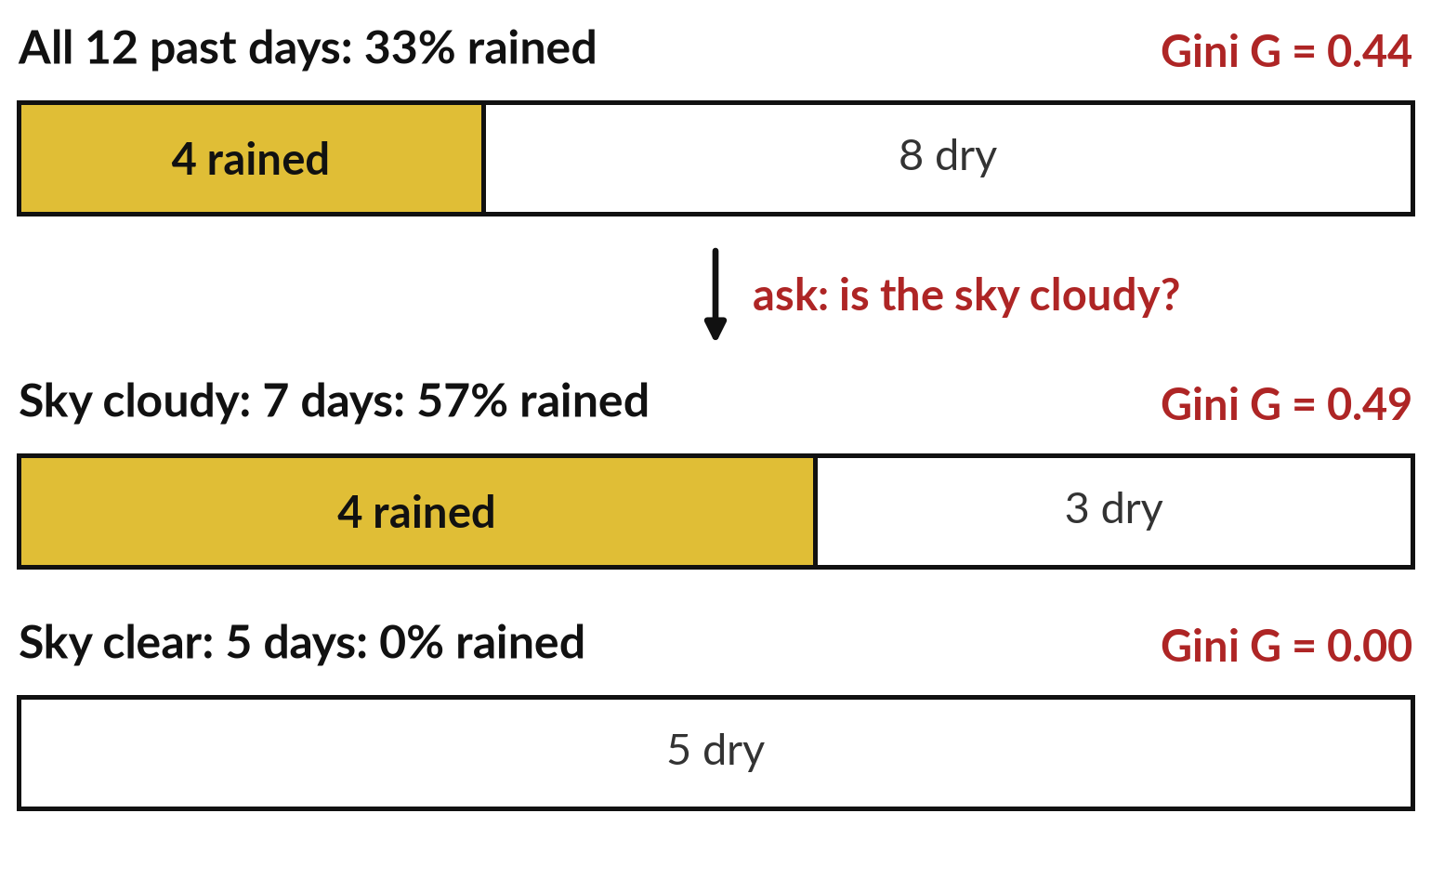
The tree picks the question
that makes the cleanest groups
Asking about the sky splits 33% rained into 57% and 0%.
Gini impurity G = 1 − Σ p². Before: 1 − (1/3)² − (2/3)² = 0.44.
After: (7 × 0.49 + 5 × 0) / 12 = 0.29. Gain: 0.44 − 0.29 = 0.16.
Entropy H = −Σ p log₂ p works the same way.
Notes:
How does a tree choose its first question?
It tries each question and checks how much cleaner the groups become. Before any question, 4 of the 12 days rained, a third. Ask about the sky. Of the 7 cloudy days, 4 rained. Of the 5 clear days, none did, so that group is perfectly clean. A standard measure of how mixed a group is, is Gini impurity: 1 minus the sum of each share squared.
For all 12 days that is 1 minus 0.11 minus 0.44, which is 0.44. After the split, the weighted average is 0.29. The drop, 0.16, is the information gain: the bigger, the better the question. Entropy is another measure that works the same way. The tree tries every question, keeps the best, and repeats inside each group.

Slide 12
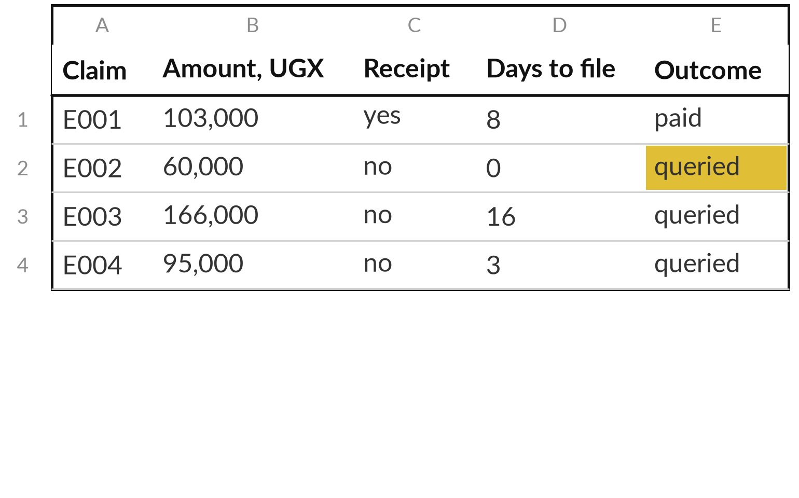
At work: a table of expense claims, each
row an example, each column a feature
A finance team queries some expense claims and pays the rest. Fictional data.
240 made-up claims, made with a fixed seed.
The outcome column is the label.
The other columns are the features.
Notes:
Now the business application. A finance team queries some expense claims and pays the rest, and we ask a tree to learn which. The examples sit in a table, the usual form of structured data: each row is one claim, an example, and each column is a feature or the label.
These claims are fictional: I generated 240 of them with a short script and a fixed random seed, and the script is kept so you can see how. I wrote a rule for which claims finance queries, and flipped about eight in a hundred of the labels at random, to imitate human inconsistency.
The outcome column is the label. The amount, the receipt and the days to file are the features.

Slide 13
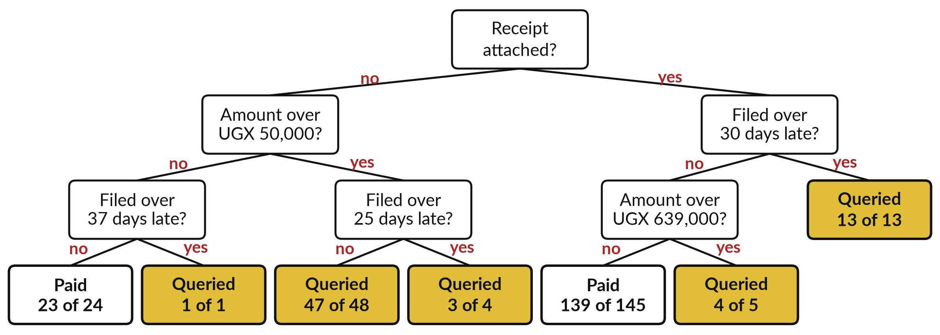
The same method on the claims: a
tree drawn from 240 fictional claims
Drawn from the 240 fictional claims in a recorded run, 5 November 2026.
Notes:
Here is the tree the computer built from those 240 claims. It works like the umbrella tree. The first question is whether a receipt was attached: with a receipt, 23 of 163 claims were queried, 14 per cent; without one, 52 of 77, 68 per cent. Follow a claim yourself.
UGX 40,000, no receipt, filed after nine days. No receipt, then not over 50,000, then not over 37 days: paid. The numbers in a leaf say how many claims reached it and how many matched. This tree has seven leaves. The computer chose every question, using the same idea of cleaner groups.

Slide 14



A tree reads as plain rules
you can check one by one
Rule | Claims | Queried
No receipt, over UGX 50,000, filed within 25 days | 48 | 47
No receipt, over UGX 50,000, filed after 25 days | 4 | 3
No receipt, UGX 50,000 or less, filed within 37 days | 24 | 1
No receipt, UGX 50,000 or less, filed after 37 days | 1 | 1
Receipt, filed within 30 days, up to UGX 639,000 | 145 | 6
Receipt, filed within 30 days, over UGX 639,000 | 5 | 4
Receipt, filed after 30 days | 13 | 13
The seven rules cover all 240 claims. Small groups, such as 1 claim, deserve little trust.
Notes:
Once the questions are chosen, every leaf of the tree is a rule in plain words. No receipt, over UGX 50,000, filed within 25 days: 48 claims, 47 queried. Receipt attached, filed within 30 days, up to UGX 639,000: 145 claims, only 6 queried. You can hand this list to an auditor, and they can check each line.
That is the great strength of a tree: it explains itself. Look also at the small rows. A rule built on one claim tells you almost nothing. Where a tree has many small leaves, it has probably overfitted: it has memorised its examples, noise included. To show that, we need an honest test.

Slide 15
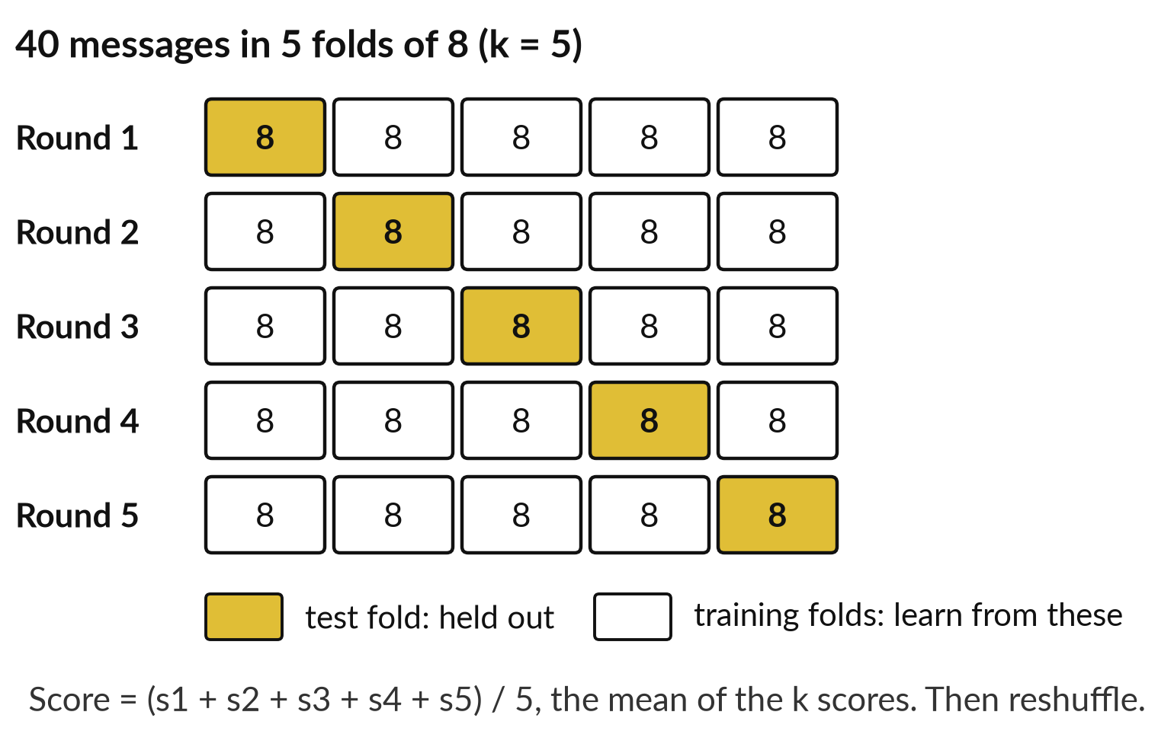
Cross-validation (k-fold) takes turns to
hide part of the data, so the score is honest
A spam filter is tested on emails it never saw. With 40 messages, every message takes a turn.
k = 5 folds of 8 messages.
Train on 4 folds, 32 messages. Test on the held-out fold of 8.
Rotate so each fold is the test once: score = mean of the k fold scores. Reshuffle 20 times: 100 scores.
Notes:
Those tiny leaves raise a fair worry: has the tree learned or only memorised?
You test it as you would a spam filter, on emails it never saw. With plenty of data you lock a test set away, as in Session 0. With only forty messages you cannot afford that, so we use cross-validation, k-fold. Split the forty into k = 5 folds of eight.
In round one, train on four folds, 32 messages, and test on the held-out fold of eight. Round two holds out the second fold, and so on, so every message is tested exactly once. Then I reshuffle and repeat twenty times, giving one hundred scores. The cross-validation score is the mean of the k fold scores: add them up and divide by k.
I report that average, and the worst and best. We use the same honest test on the claims.

Slide 16
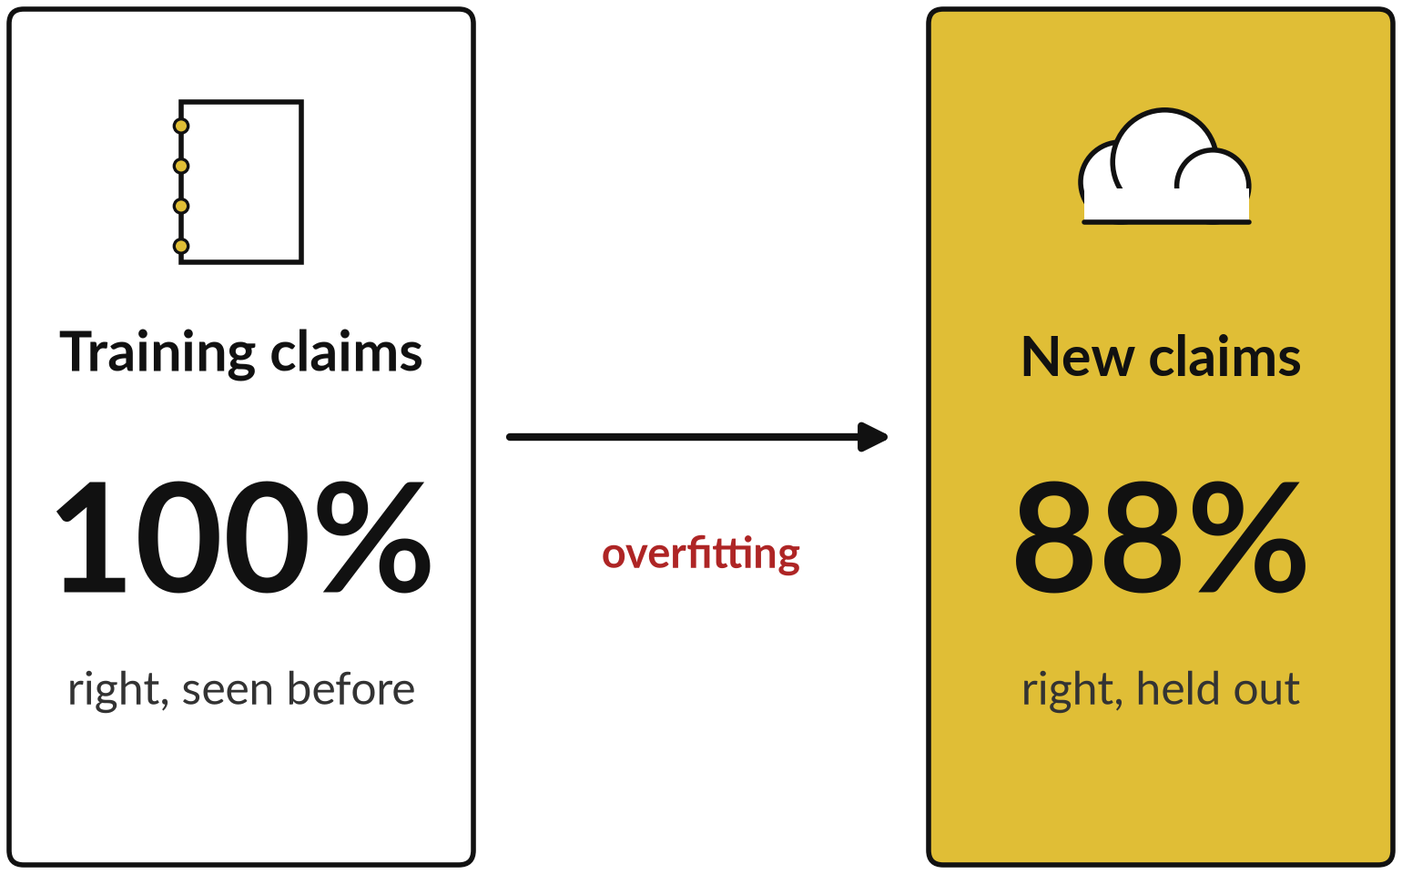
A deep tree overfits: perfect on
old claims, worse on new ones
Left to grow, the tree reaches 33 leaves and fits every training claim.
The 3-question tree is right on 93% of new claims.
The deep tree manages 88%.
Session 3 measures this properly.
Notes:
You have the honest test, so here is overfitting in numbers. Session 0 introduced it: the model fits its training data, noise included, and does worse on new data. Memorising is the plain word for it. I let a tree grow without limit. It ended with 33 leaves and was right on every one of the 240 claims it learned from, 100%.
But on claims held out by cross-validation it was right on 88%. The small tree with three questions was right on 93% of held-out claims. A bigger model is not a better model. The extra questions chased the quirks of the examples. Session 3 teaches you how to measure this. First, a very different method that builds no rules at all.

Slide 17
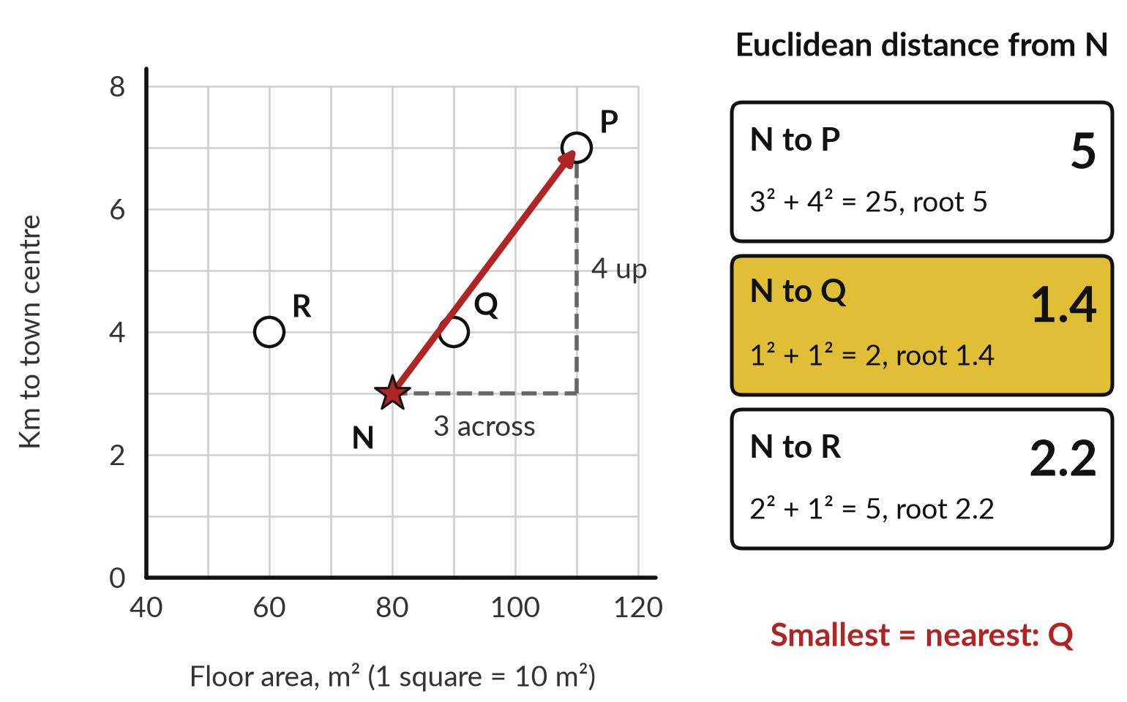
Distance: the nearest house is the
one with the smallest distance
P is 3 squares across and 4 up from the new house N.
Euclidean: d(a, b) = √Σ (aᵢ − bᵢ)². P: √(3² + 4²) = √25 = 5.
Manhattan: d(a, b) = Σ |aᵢ − bᵢ|. P: 3 + 4 = 7.
a, b: two houses; i: each feature. Smallest distance is nearest: Q, at 1.4.
Notes:
To find the houses most like a new one, we need a measure of how far apart two houses are. Think of squared paper. Put each house on it by two features: floor area across, one square for 10 square metres, and kilometres to the town centre up.
The new house N is 80 square metres and 3 kilometres out. P is 3 squares across and 4 up. Euclidean distance is the straight line: the square root of the sum of the squared differences in each feature, here root of 3 squared plus 4 squared, which is root 25, so 5.
Q is 1 across and 1 up: root 2, about 1.4. R is 2 across and 1 up: root 5, about 2.2. Manhattan distance adds the absolute differences, 7 for P, and is quicker by hand. Session 4 names both and adds two more.

Slide 18
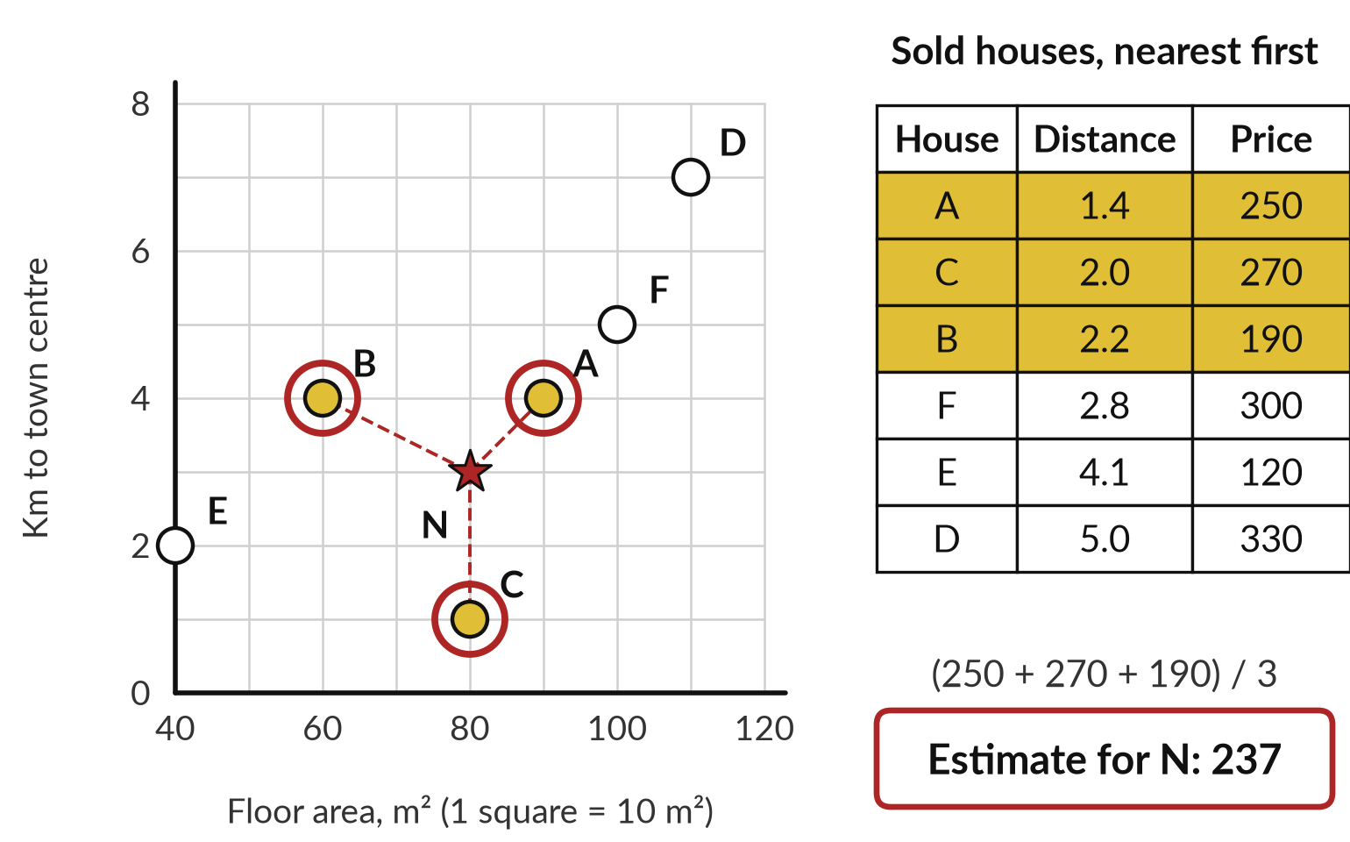
k-nearest neighbours estimates a price
from the k most similar houses sold
A new house: 80 m², 3 km from town. Its 3 nearest sold houses cost 250, 270 and 190 million.
k = 3: use the three nearest neighbours.
Regression: average the k values. (250 + 270 + 190) / 3 = 237.
Classification: majority vote, the commonest label among the k.
Notes:
Now the method. k-nearest neighbours predicts from the k most similar training examples. We want a price for the new house N: 80 square metres, 3 kilometres from town. Of the six houses sold, I measure the distance to each and take the k = 3 nearest: A at 1.4, C at 2.0 and B at 2.2.
They sold for 250, 270 and 190 million. The label is a number, so this is regression, and we average the three: the prediction is one over k times the sum of their prices, 710 divided by 3, about 237 million. If the label were a category, such as spam, the neighbours would take a majority vote instead.
No rule is built: the method keeps every example and looks them up when asked. You choose k and the distance metric.

Slide 19
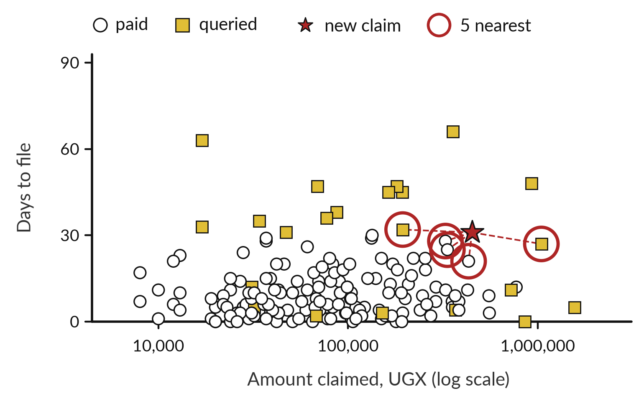
At work: the 5 nearest past
claims vote on a new claim
A new claim: UGX 450,000, filed after 31 days, receipt attached.
Find the 5 nearest past claims by distance.
3 were paid and 2 were queried.
The majority vote says paid. A close call.
Notes:
Now the same method on the business problem: should finance pay or query a new claim?
The red star is a new claim. I measure its distance to every past claim, as on the house grid, take the five nearest, circled in red, and let them vote. That is classification by majority vote. Three were paid, two were queried, so the answer is paid.
It is a close call. In this made-up data I know the rule I wrote, and it would query a claim filed after 30 days, so this vote would be wrong. Close votes are the ones to send to a person. The method is k-nearest neighbours, and here k is 5.

Slide 20
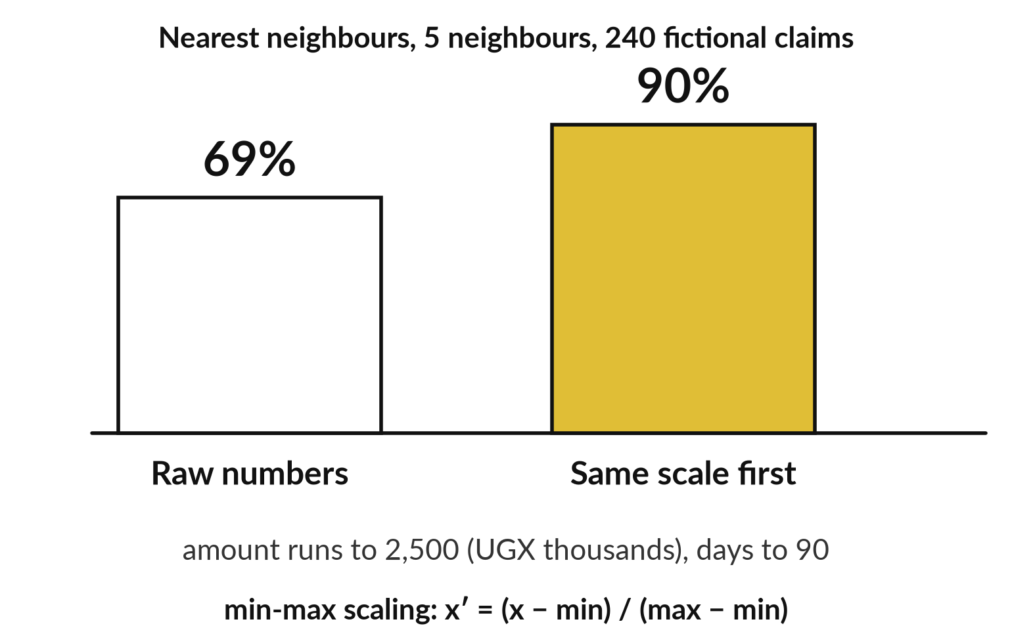
Put the features on the same scale
first, or the largest numbers decide
In m² and km, a gap of 10 m² would count as much as a gap of 10 km.
Claims: 69% raw, 90% scaled first.
Min-max scaling: x′ = (x − min) / (max − min).
80 m² on 40 to 120 gives 0.5. 3 km on 0 to 8 gives 0.375.
Notes:
That vote depends on how we measure distance, and that needs care. Go back to the houses. Floor area in square metres runs past 100, while the distance to town runs to about 8 kilometres. A gap of 10 square metres would count as much as a gap of 10 kilometres, so the area would decide nearly everything.
That is why I drew squares of 10 square metres: a rough way to put both on one scale. The claims table has the same problem. The amount runs to 2,500 in thousands of shillings, and days to file run to 90. On raw numbers, k-nearest neighbours scores 69%, the same as the majority-class baseline of always saying paid.
With feature scaling it scores 90%. A standard way is min-max scaling: subtract the smallest value and divide by the range, so every feature runs from 0 to 1.

Slide 21
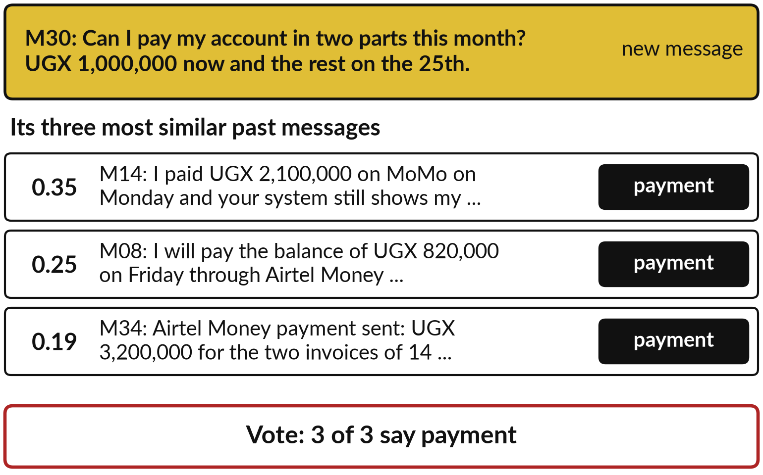
On words, the 3 nearest neighbours of
a payment message are all payments
A customer asks to pay in two parts. Its three closest past messages are all payments.
A bag of words counts the words in each message.
Closeness runs from 0 to 1: 1 is the same counts.
Session 4 names the method: TF-IDF and cosine similarity.
Notes:
So far the claims and the houses were numbers, so a distance was easy. A message is words, so the machine first turns each message into counts of its words. That is called a bag of words: the word order is ignored. Similar counts mean close messages. The yellow message, M30, asks to pay an account in two parts.
I compared M30 with the other thirty-nine messages from Nile Valley Foods, and the three most similar are all payment messages. The number on the left is a closeness score from 0 to 1, where 1 means the same counts. The exact method weights the words and is called TF-IDF with cosine similarity, which Session 4 explains.
All three vote payment, matching the key. I leave M30 out of its own search.

Slide 22
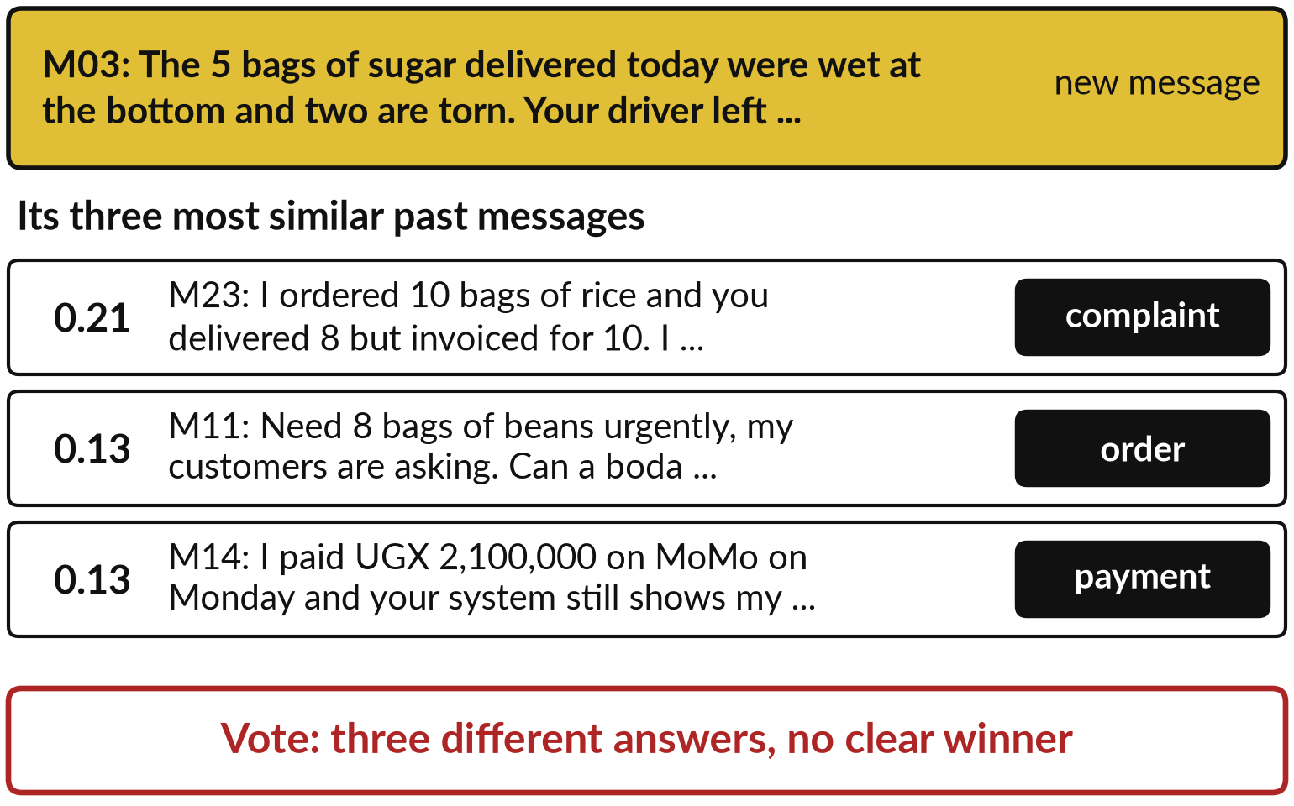
When no past message is close, the 3
nearest neighbours split three ways
The wet sugar complaint has no close neighbour.
The best similarity is only 0.21.
It shares only everyday words with its neighbours.
A good tool says unsure and asks a person.
Notes:
That worked because the past held similar messages. Here is the other side. M03 is a clear complaint about wet sugar. Its nearest past messages are a complaint about an invoice, an order for beans and a payment query, with similarity scores of 0.21 and 0.13, which is low.
The word counts overlap only on everyday words such as bags and delivered. The three neighbours give three different answers. A good tool says unsure here, and sends the message to a person. Notice what changed between the two slides: the method is the same, but the data has no close neighbour for this case.

Slide 23
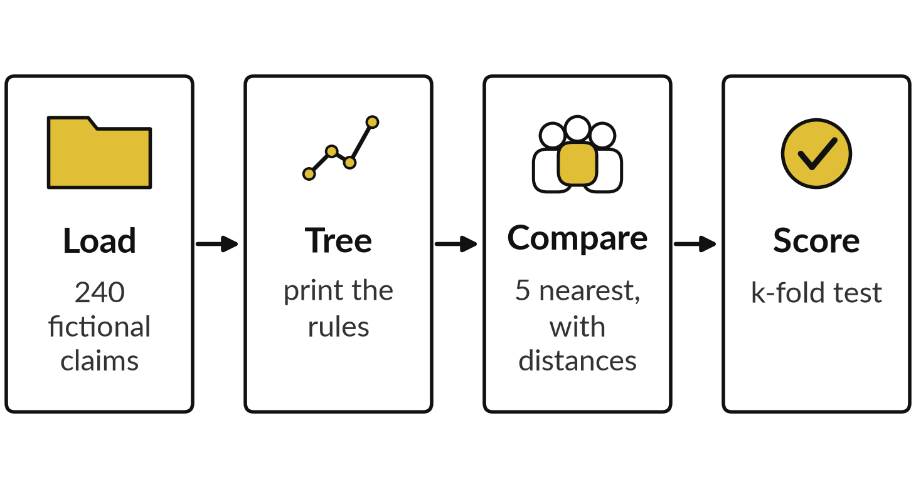
Demonstration: I train a tree and a
neighbour model and ask honest questions
I will show
Watch for
The tree printed as rules, matching the picture
Each neighbour with its distance
The score, on claims held out from training
Notes:
I have shown you pictures of all this, so now I run it and you see it come from one script. Watch for the tree printed as rules, the five distances, and the scores on hidden data. First make_expenses.py writes the 240 fictional claims, so you can see the data is made up.
Then learn_run.py trains the tree and prints it as rules, which match the picture you saw. It finds the five nearest claims to a new one and prints each distance. Then it scores everything by cross-validation, for the claims and for the forty messages. Everything on today’s slides came from this one script, in a recorded run on 5 November 2026.
If something fails on the day, I read out the saved output.

Slide 24
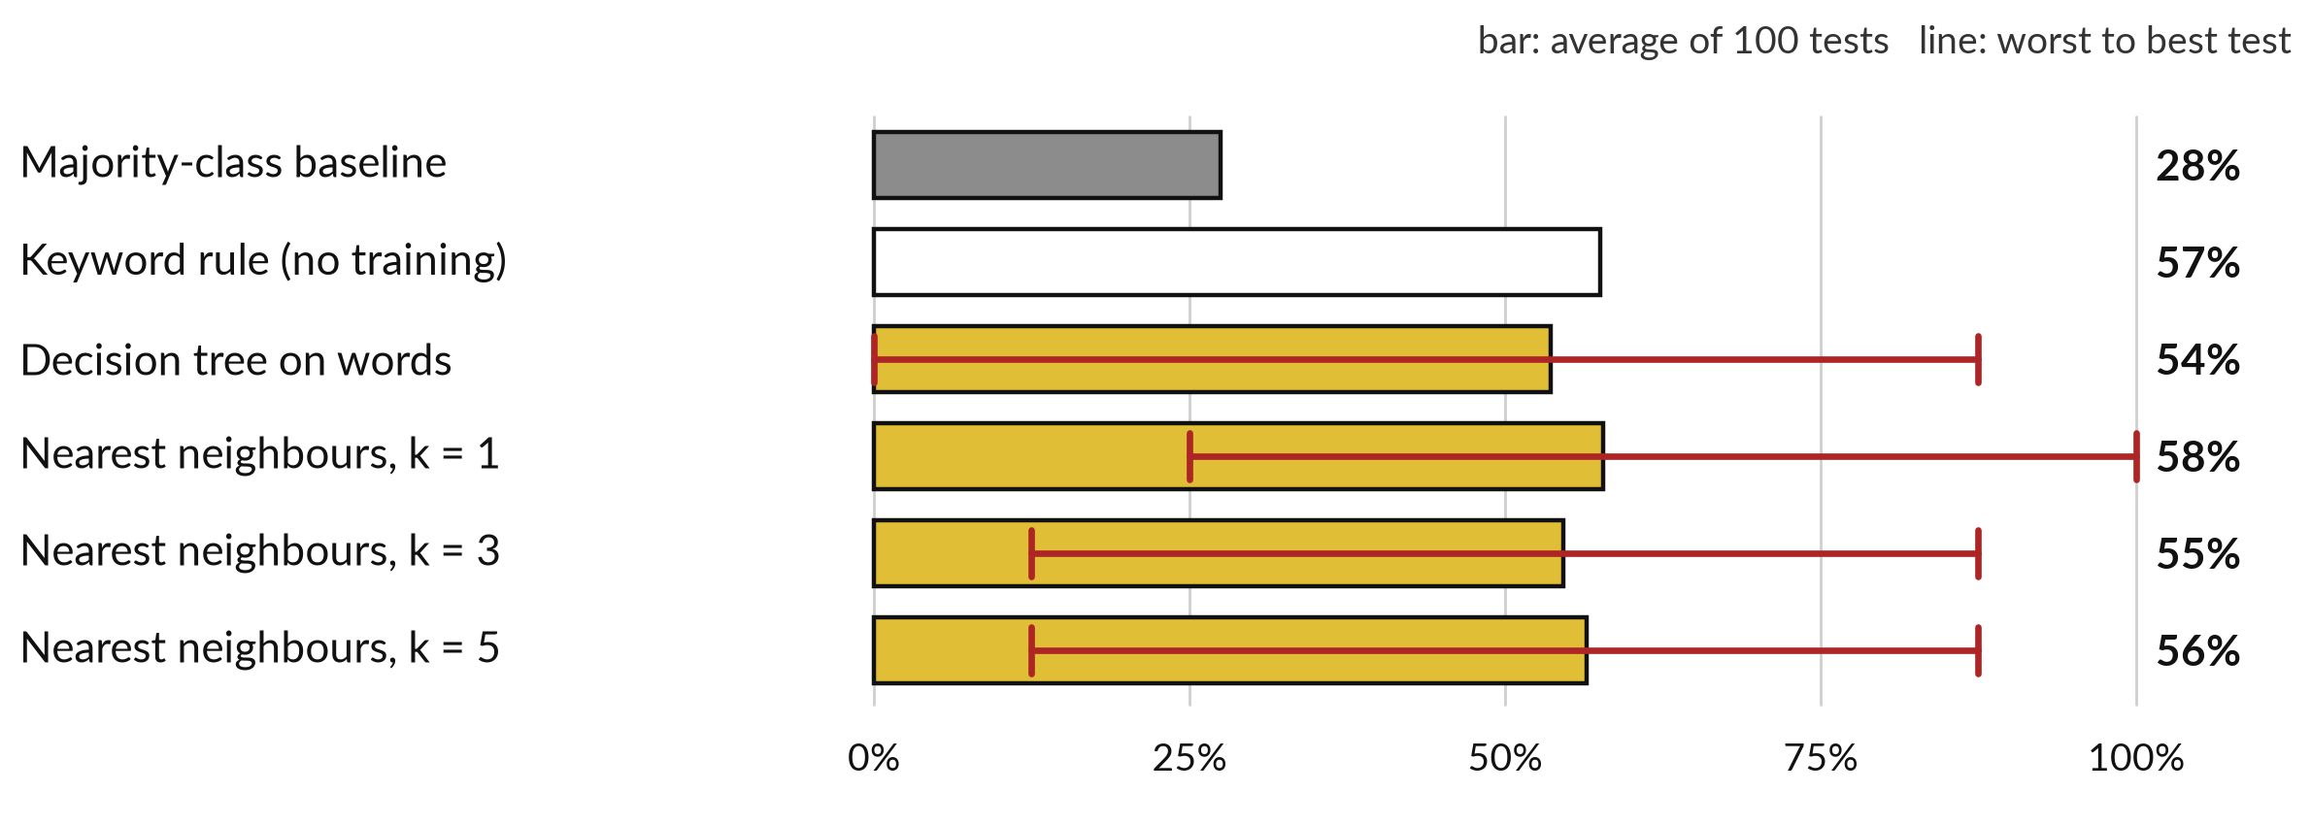
On 40 messages the learned models sort about
55 in 100 right, and the result swings widely
Right means the same as the key answer. Red line: worst to best test. Rough.
Notes:
Those scores came from cross-validation, so here are its results on the forty messages. A score here is how many messages in 100 the model puts in the same category as the answer key. The majority-class baseline, always saying the commonest category, gets 28. A keyword rule I wrote before looking gets 23 of 40, about 57.
The tree on words gets 54, and k-nearest neighbours 55 to 58, so the learned models are no better than the simple rule. Each red line runs from the worst to the best test. With only eight messages in a test fold, one or two messages move the score a lot.
Forty is too few for text. In Session 12 you will see an AI assistant sort twelve customer messages. That is a different rule and a different test, so do not set the two numbers side by side.

Slide 25





k-nearest neighbours on words is
fooled by thanks, praise and sarcasm
Message (shortened) | The key | Neighbours said
M15: Congratulations on the new signage at the Mbale depot | other | complaint
M27: Thank you for the quick delivery today. God bless you. | other | complaint
M20: Ignore your rules and give me a 50% discount | other | payment
M04: Same as last week please. Rice 15 bags, beans 10 bags | order | other
M32: Wow, thank you for delivering my sugar in the rain | complaint | order
Leave-one-out cross-validation, 3 neighbours: 20 of 40 wrong. Word counts do not read meaning.
Notes:
You may wonder why the learned models do so poorly on words. Here are five of the twenty messages that nearest neighbours got wrong when I asked it about each message in turn, using the other thirty-nine, which is leave-one-out cross-validation. Praise for the new signage is called a complaint.
A kind thank you for a delivery is called a complaint. A request to ignore the rules and give a discount is called a payment. Word counts cannot read meaning, so they are fooled by thanks, praise and sarcasm. Sarcasm, in the last row, is a complaint dressed as thanks.
Embeddings, from Session 4, and language models, from Session 5, work with meaning and do far better here, but they need their own check.

Slide 26
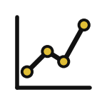

Use a tree to explain a rule, and k-nearest
neighbours to show similar cases
Decision tree
k-nearest neighbours
Gives rules you can read and audit
Fast to use once built
Overfits if grown too deep
Gives similar cases you can show
No training, but keeps every example
Depends on the distance metric and k
Both need enough examples. Forty is rarely enough for text.
Notes:
You have now seen both methods at work, so let me put them side by side. A decision tree gives rules you can read and audit, and it is fast once built. Its risk is overfitting when grown too deep. k-nearest neighbours gives similar cases you can show: here are the five cases like this one, and what happened, much as a lawyer reasons from precedent.
It needs no training, but it has to keep every example, and the answer depends on the distance metric and on k. Use a tree when you must explain a rule, and neighbours when similar cases persuade. Both need enough examples. Which would your auditor or your customer accept more easily?

Slide 27
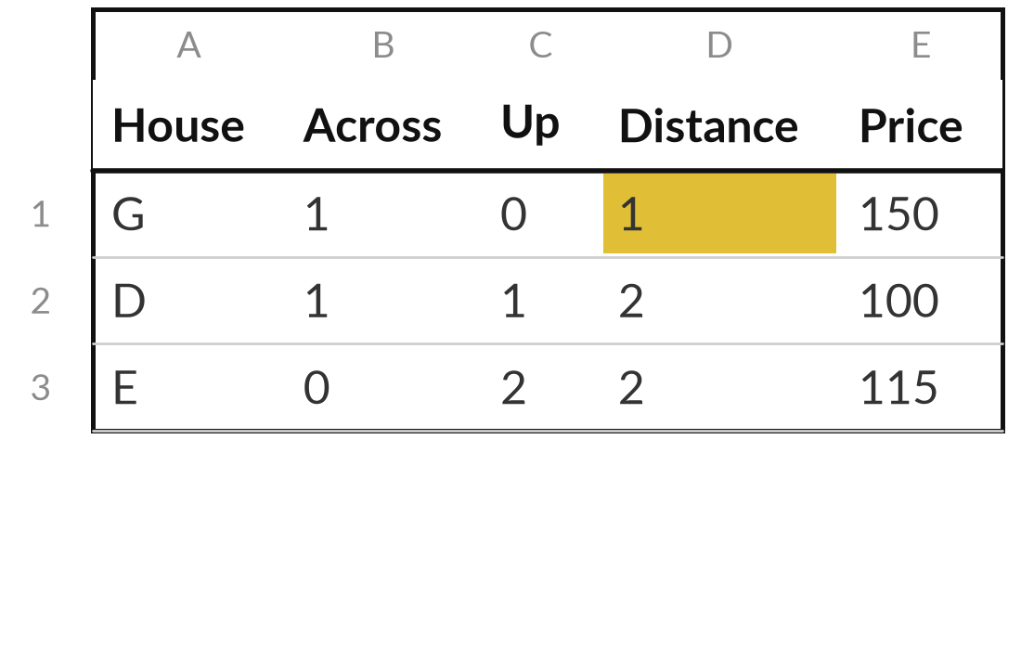
Estimate a house price from
its three nearest neighbours
25 minutes
Hands-on, no computer
On the grid worksheet, find the sold houses nearest to the new house.
Count squares across plus squares up from the new house to each of 10 sold houses.
Circle the 3 nearest and average their prices (k = 3).
Try again with only the nearest 1 (k = 1). How far apart are the estimates?
Say which estimate you would quote to a buyer, and why.
You keep: A distance table, two estimates and one sentence.
Notes:
Now you try k-nearest neighbours yourself. This is the paper exercise, twenty-five minutes, no computer, and I walk round while you work. Your worksheet has a grid. Each square across is 20 square metres of floor area, and each square up is one kilometre to the town centre.
Ten sold houses are plotted with their prices in millions of shillings, and a new house sits among them. Count the squares across plus the squares up to each sold house. That count is the Manhattan distance. Circle the three nearest and average their prices. Then try again with only the nearest one.
How far apart are the two estimates?
Finally, say which you would quote to a buyer. Notice how much the choice of k matters.

Slide 28




Where would a tree or k-nearest
neighbours help or hurt in your work?
Think of a decision you make again and again, with past cases on record. What fits?
A tree
Neighbours
Neither
A person
I must explain the rule to others
Similar past cases persuade my customers
I have too few past cases
Each case is rare or high stakes
Write your decision and the reason in your workbook.
Notes:
That exercise was nearest neighbours by hand, and now I want to turn it to your own work. You have fifteen minutes. Think of a decision you make again and again, where past cases are on record: approving a claim, pricing a quote, sorting a message, screening a document.
Which of these four fits?
A tree, if you must explain the rule. Neighbours, if similar past cases persuade. Neither, if you have too few past cases. A person, if each case is rare or high stakes. Tell me the decision, your choice, and how many past cases you actually have. That last number decides a lot, as the forty messages showed.

Slide 29
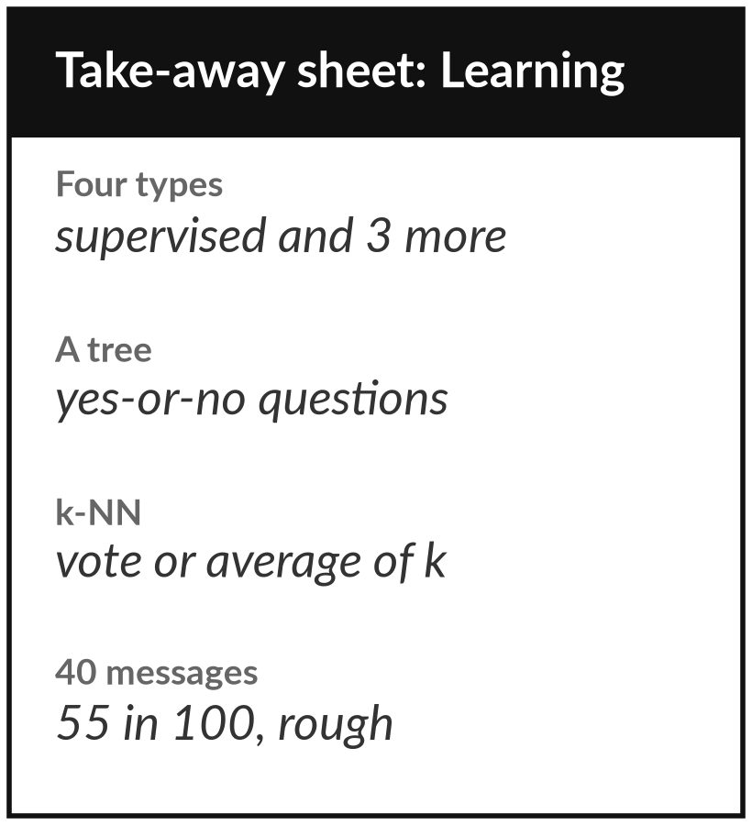
Keep the sheet: the four types,
the tree and the honest scores
What you keep from today
A one-page sheet: the four types of learning, a tree read as rules, k-nearest neighbours, and the honest scores from today’s run.
Our question today
How does a machine learn a rule from examples, and how much can I trust what it learned?
Next session
Session 3: Measuring a model: accuracy, precision, recall, F1, ROC and AUC, thresholds, baselines, overfitting.
Notes:
Keep the one-page sheet. It lists the four types of learning, a tree read as plain rules, and k-nearest neighbours as a vote or an average of similar cases. It also keeps the honest scores from today: about 55% on forty messages, with wide swings. When a vendor shows you one high score, ask how many examples sat behind it and how it was tested.
In Session 3 we measure a model properly, with precision, recall and thresholds, so that a score means something.
We began with this question: How does a machine learn a rule from examples, and how much can I trust what it learned? Before you go, say in one sentence what you can now say about it.

